Slide 1
Trading System
Siqi lou / Jinqing xu / jiawen wu

Slide 2
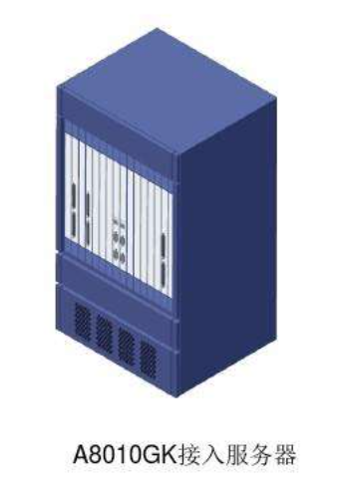
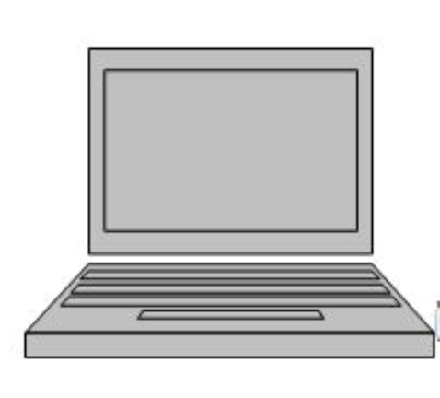

Architecture: B／S
Firm A
Broker A
Trader A
Trader Gateway
Broker Gateway
Broker UI
Trader Database
Broker Database
Trader B

Slide 3
Gateway Connection: JMS
Trader Gateway A
Trader Gateway A
Trader Gateway A
MakeOrder
Broadcast
OrderBook
Broker Gateway A
Broker Gateway A

Slide 4
UI/Gateway Conn: RESTful + Websocket
Trader A
Make Order (RESTFul)
Trader Gateway A
Trader B
Frush OrderBook (WebSocket)

Slide 5
Data structure
BrokerGateway
UI
Orderqueue
OrderBook
DisPlayBook

Slide 6
Process Order
trader
redis
BrokerGateWay
NormalThread
Stop order
Orderbook change
LimitThread
CancelThread

Slide 7
Data Structure: MySQL + MongoDB
MySQL
MongoDB
firm
order
transaction
Price Log
Product
Cancel Order

Slide 8
Scalability
Nginx
Broker1
Proxy
Trader1
Broker2

Slide 9
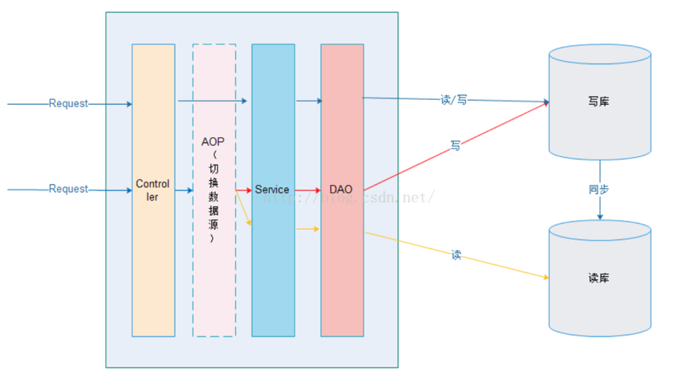
Scalability
mysql

Slide 10
Load Balance: Broker-Cluster Deploy
Producer
Broker1
Consumer
Broker2
Broker3

Slide 11
Load Balance: Broker-Cluster Deploy
Producer
Broker Hub1
Broker Hub2
Consumer
Broker2
Broker3
Broker1

Slide 12
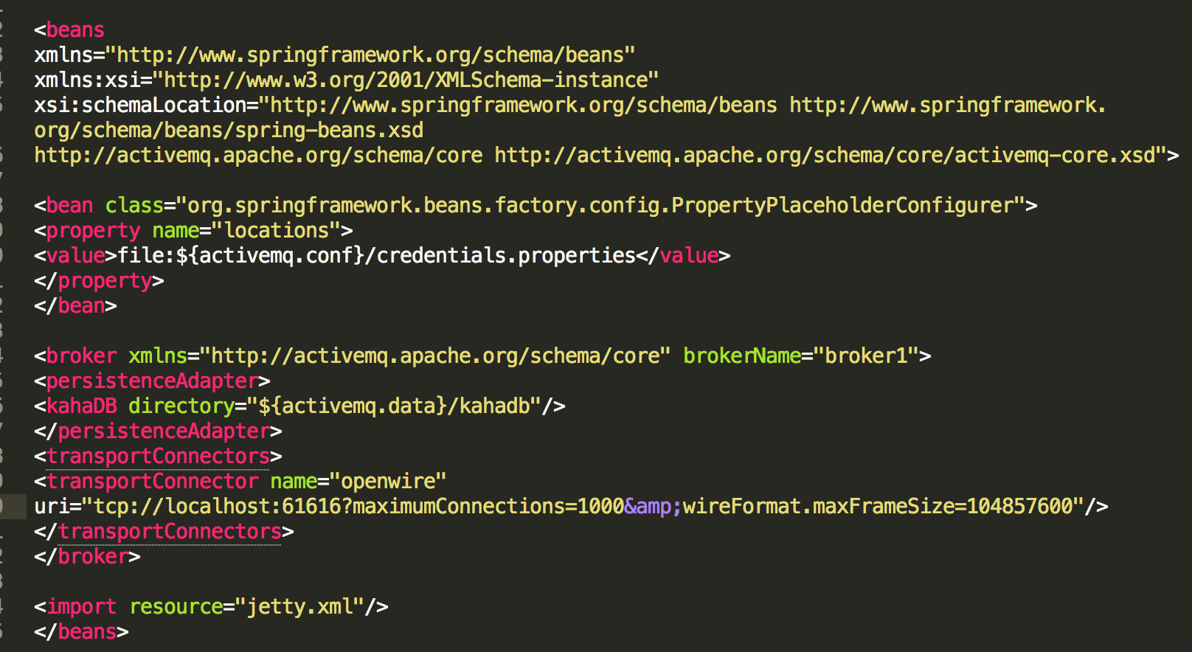
Load Balance: Broker-Cluster Deploy
activemq1: 61616 (broker1)
activemq2: 61626 (broker2)
activemq3: 61636 (broker3)
activemq4: 61646 (broker-hub1)
activemq5: 61656 (broker-hub2)

Slide 13
VWAP
Split by hours
Equal proportion with the sum deal number in an hour.
Forecast by the past data
Moving window

